Slide 1
Lead score case study
Group members:
Joga vyshnavi latha
Sushreema sahoo
Sarthak Mishra

Slide 2
Problem statement:
X education wants model building in order to sell their online courses to industry professionals.
X education get to find out that their lead conversion rate is very low. To make this process more efficient, the company wishes to identify the most potential leads, also known as ‘Hot Leads’ by building model and evaluate them.
If this model got succeeded this will in turn helps them to gain high conversion rate by effectively contacting the potential leads by avoiding unnecessary calls to everyone from whom there is no effect for their business.
This will enables them for the deployment of model for their future best results.

Slide 3
Data manipulation
There are totally 37 rows and 9240 columns in the data set.
By checking info of data set. Prospect id and lead number are of same purpose so, decided to drop them. Along with this columns names are long hence renamed them.
There are 5 columns with high null values such as “country” , “specialization”, “occupation”, “course_selection_reason”, “city” dropped them.
Dropping the columns having more than 35% as missing value such as ‘How did you hear about X Education’ and ‘Lead Profile’.

Slide 4
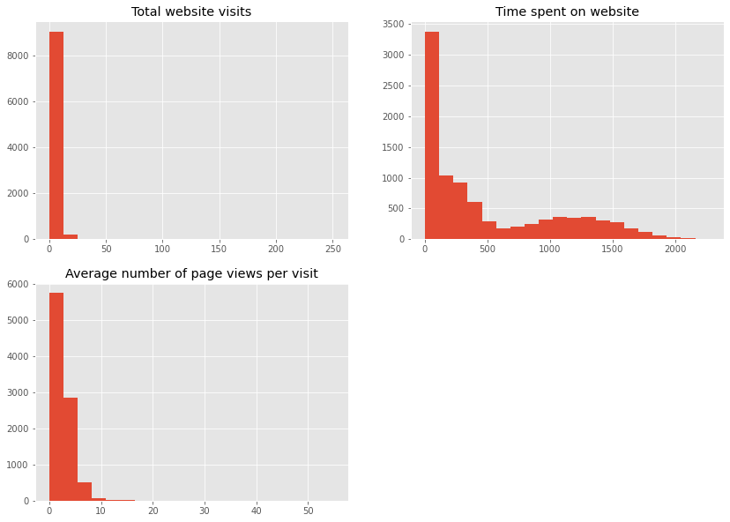
Numerical value:

Slide 5
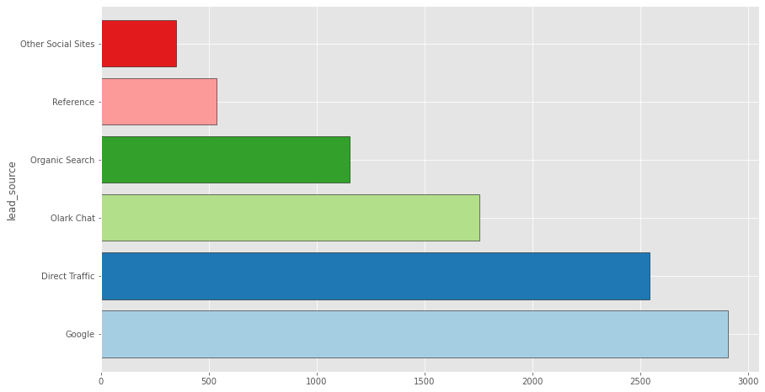
Lead score:

Slide 6
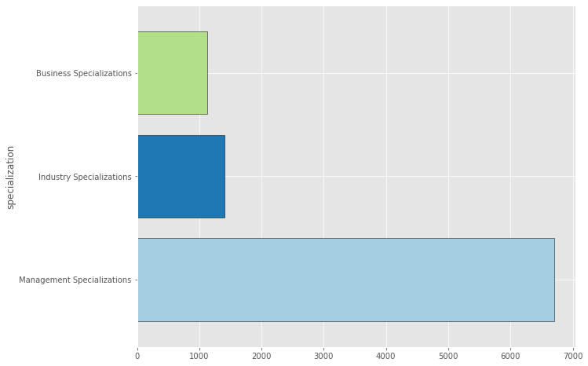
Specialization:

Slide 7
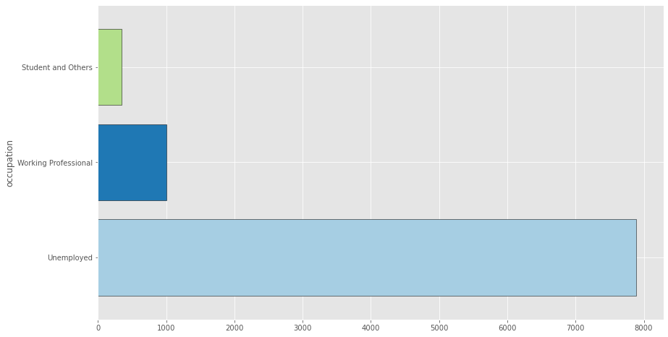
Occupation:

Slide 8
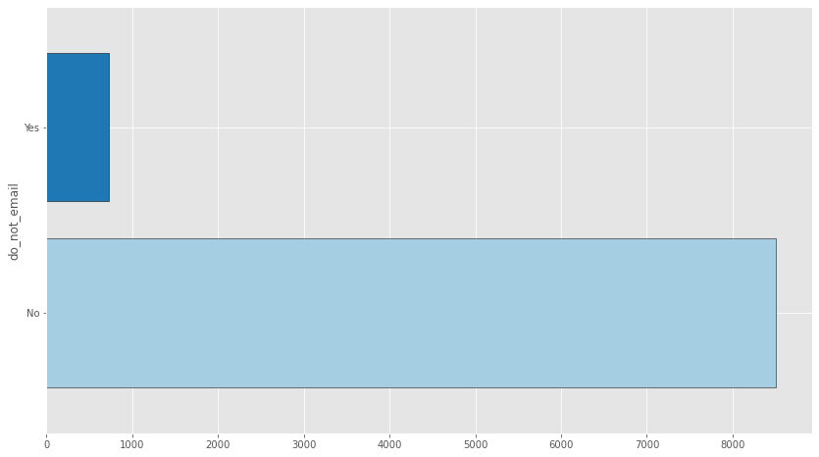
Do not email:

Slide 9
Thank you

Slide 10
Conclusion:
When their current occupation is as a working professionals. having these in mind the X Education can flourish as they have a very high chance to get almost all the potential buyers to change their mind and buy their courses.

